Slide 1
2020 Census Population and Housing Map
File created on: 10/16/2022 7:19:49 PM

Slide 2
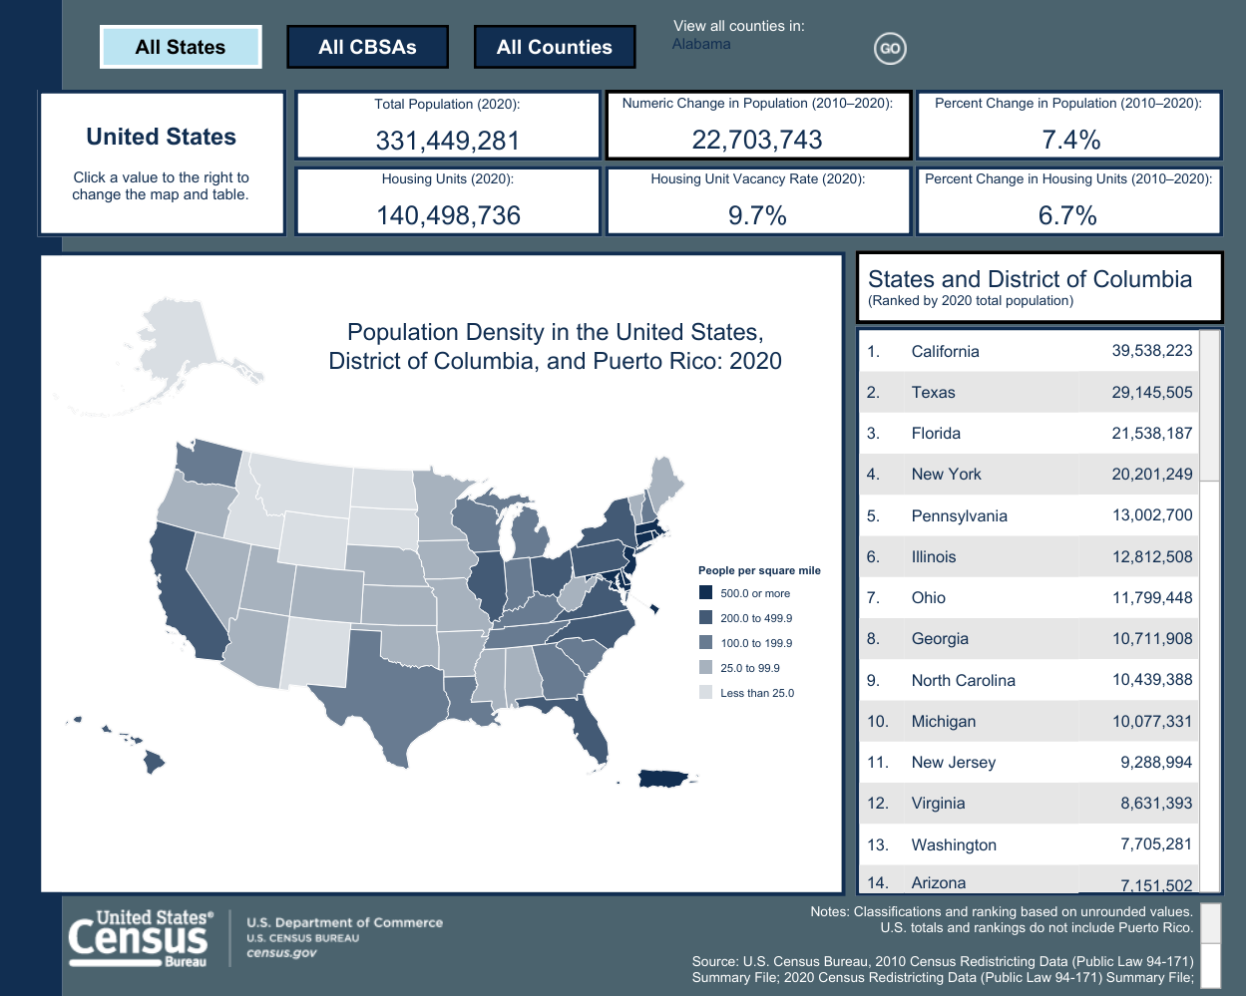

Slide 3
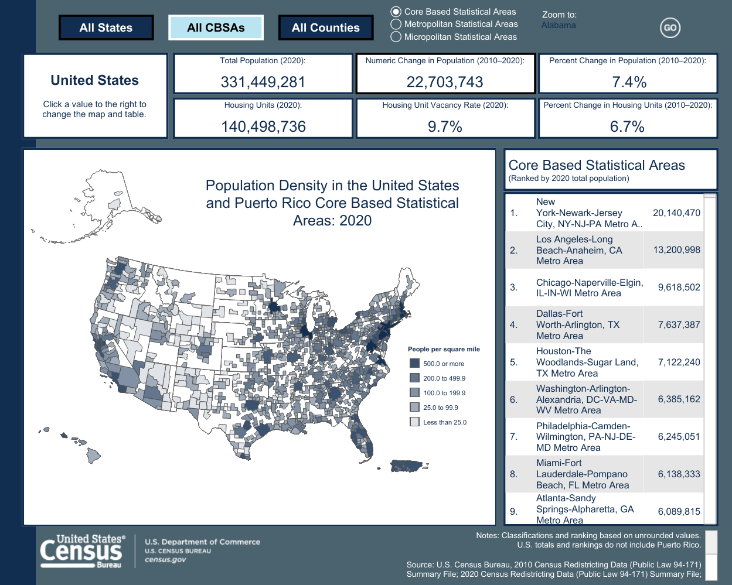

Slide 4
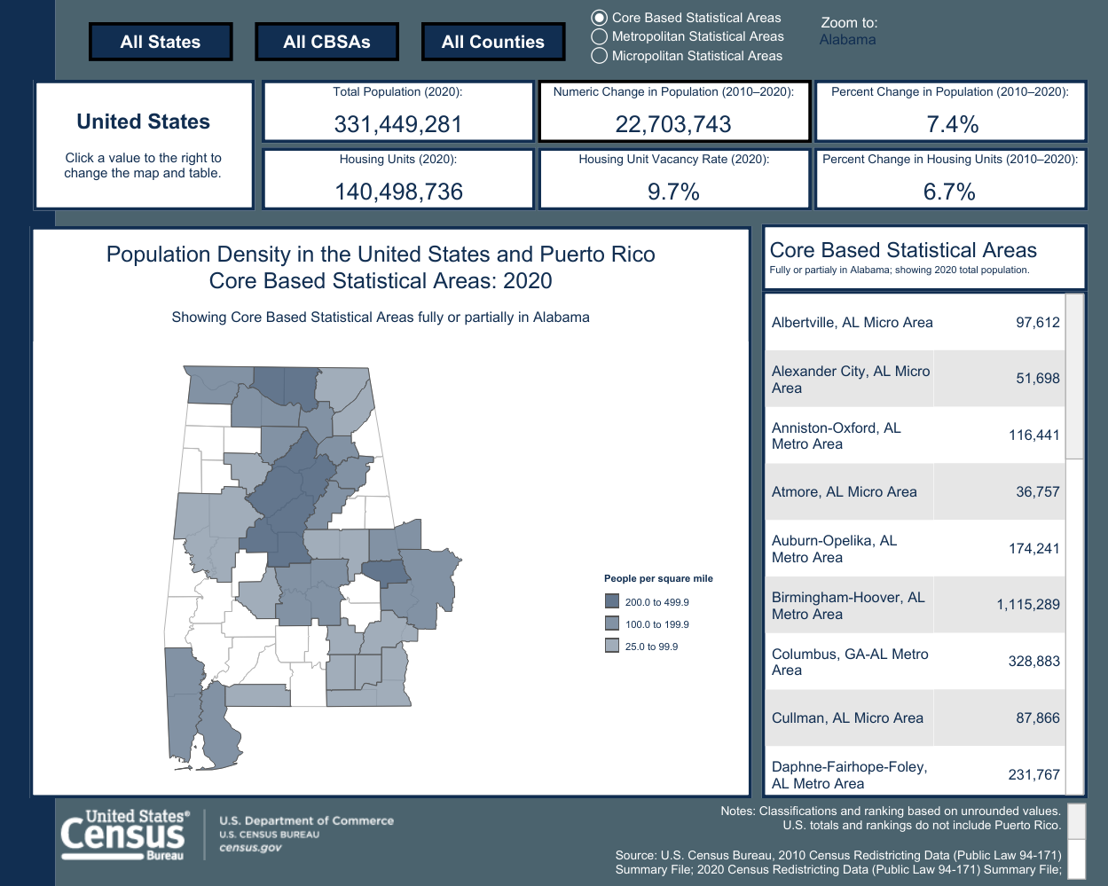

Slide 5
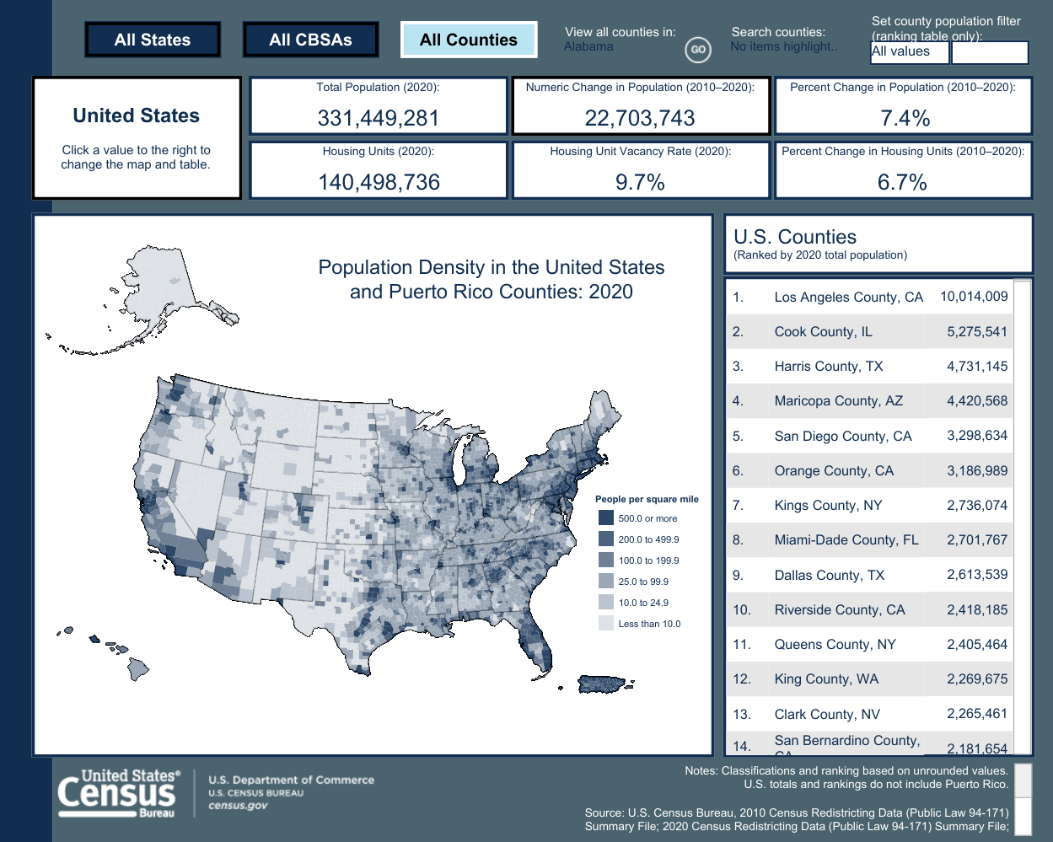

Slide 6
